Slide 1
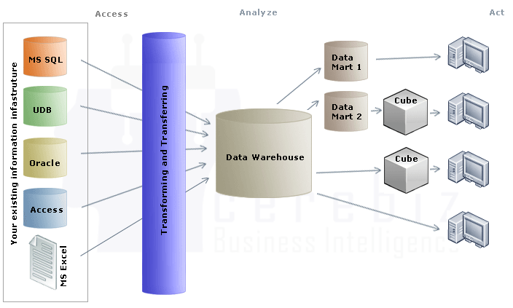
Data Warehouse Architecture

Slide 2
Outline
What is a Data Warehouse Architecture
Five Main Data Warehouse Architectures
Factors That Affect Choosing A Data Warehouse Architecture

Slide 3
What is a Data Warehouse Architecture
Primarily based on the business processes of a business enterprise
Conceptualization of how the data warehouse is built

Slide 4
Five Main Data Warehouse Architectures
Independent Data Marts
Data Mart Bus Architecture
Hub-and-Spoke
Centralized Data Warehouse
Federated Architecture

Slide 5
Independent Data Marts
Data marts that are independent of each other
Often created by organization units
Inconsistent data definitions and different dimensions and measures

Slide 6
Independent Data Marts Diagram
Source systems
Staging area
Independent data marts (atomic/summarized data)
End-user access and applications

Slide 7
Data Mart Bus Architecture
Creation starts with a business requirements analysis for a specific process such as orders, deliveries, customer calls, or billing.
One mart is created for a single business process
Additional marts are developed using the conformed dimensions of the first mart

Slide 8
Data Mart Bus Architecture Diagram
Dimensionalized data marts linked by conformed dimensions (atomic/summarized data)
Source systems
Staging area
End-user access and applications

Slide 9
Centralized Data Warehouse Diagram
Normalized relational warehouse (atomic/some summarized data)
Source systems
Staging area
End-user access and applications

Slide 10
Federated Architecture
Leaves existing decision-support structures in place
Shares information among a number of different systems
Data is either logically or physically integrated
Shared keys
Global metadata
Distributed queries

Slide 11
Federated Architecture Diagram
Existing data warehouses, data marts, and legacy systems
Logical/physical integration of common data elements
End user access and applications

Slide 12
Factors That Affect Choosing A Data Warehouse Architecture
Information Interdependence between Organizational Units
Upper Management’s Information Needs
Urgency of Need for a Data Warehouse
Nature of End-User Tasks
Constraints on Resources

Slide 13
Factors That Affect Choosing A Data Warehouse Architecture
Strategic View of the Data Warehouse Prior to Implementation
Compatibility with Existing Systems
Perceived Ability of the In-House IT Staff
Technical Issues
Social/Political Factors

Slide 14
Summary
The Data Mart Bus, Hub-and-Spoke, and Centralized Architectures are the most used
Many factors affect the choice of a Data Warehouse Architecture
Some Data Warehouse Architectures can be implemented on existing systems

